Slide 1
Lecture 1b: Introduction to R

Slide 2
About R
R is an open source comprehensive statistical package, more and more used around the world.
R is a real programming language (compare to SAS or Minitab)
R is not low-level language as C or Visual Basic
Can be compared to Matlab by structure, by origin – free version of S
+ Has a lot of contributed packages covering a lot of statistical methods (also recent ones!)
- Documentation is badly structured

Slide 3
Installing the R software
R project web site: http://www.r-project.org/
Find the mirror nearest to you when downloading

Slide 5
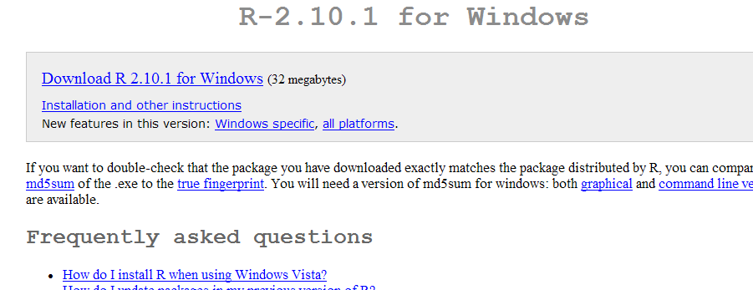
Wise to read this first!

Slide 6
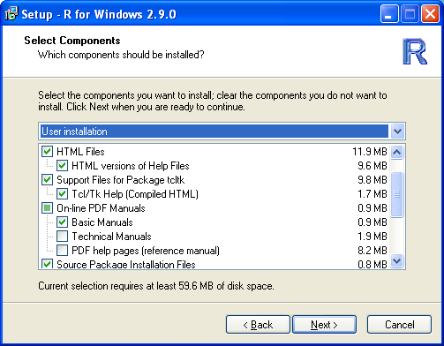
Install with PDF Manual included !!
Check this box!
(All boxes can be checked if you have enough memory space.)

Slide 7
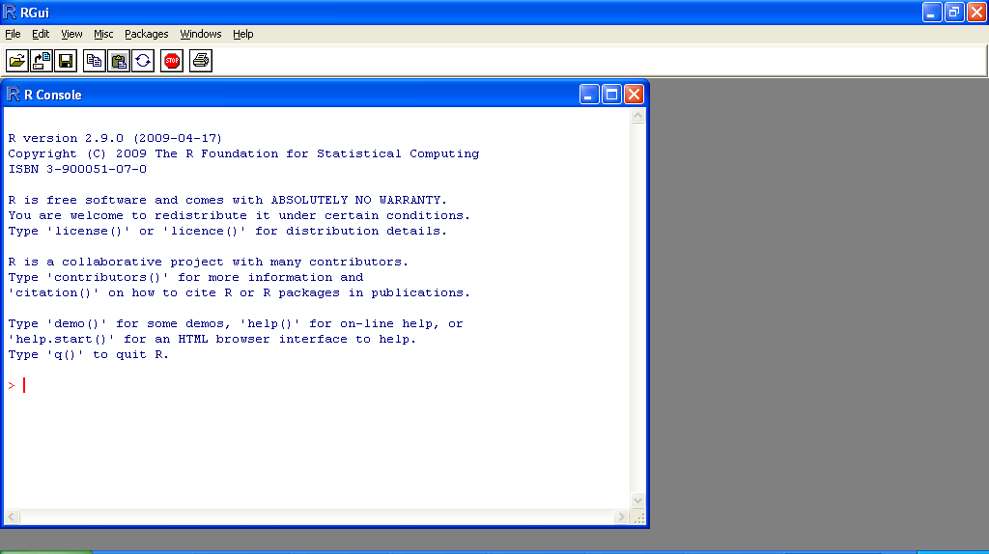
Start→(All )Program→R→R 2.9.0

Slide 8
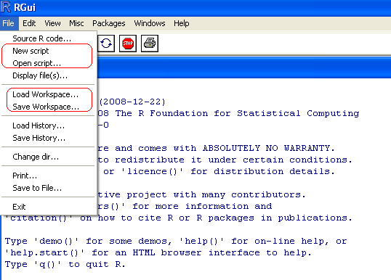
Important menu items

Slide 9
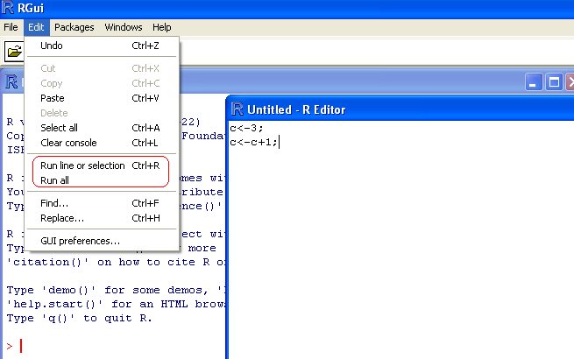
Important menu items

Slide 10
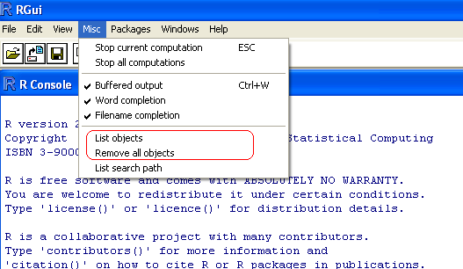
Important menu items

Slide 11
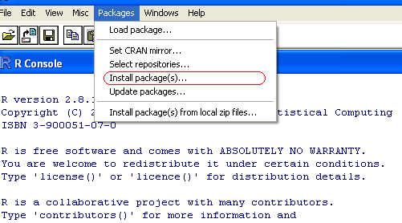
Important menu items

Slide 12
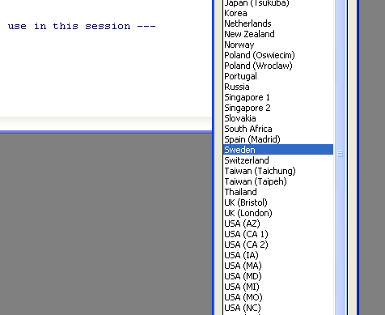
Important menu items

Slide 13
Gettting help
Specific function
help(function)
Help browser
help.start()
Search for something in help
help.search(“expression”)

Slide 14
Preliminaries
R is case-sensitive
Separate commands by semicolon (;)
Comments:
#R is a very cool language!
Data assignment:
Use -> or <-
a<-3;
3->b;

Slide 15
Working with verctors
Assign a vector
The function c() combines individual values (comma-spaced) to a vector
Printing the value on screen:
Either enter the variable or use the function print()
Note that the output begins with [1]. This is the row number, and in this case x is interpreted as a row vector

Slide 16
Listing and removing objects
Listing defined objects (vectors, matrices, data frames):
Use the function ls() with no arguments
Removing objects:
Use the function rm()

Slide 17
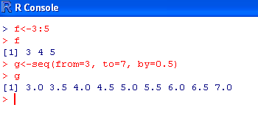
Sequences
Use either ‘: ‘ or seq()

Slide 18
Operation with vectors
Element-wise: +-*/^
log exp sin cos
length –number of elements
sum - sum of all elements
max min sort
Logicals:
TRUE or FALSE:
a<-TRUE;
> >= < <= != & (and) | (or)

Slide 19
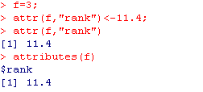
Attributes
Each object in R may have attributes (especially used in working with functions)

Slide 20
Working with matrices
Alternative 1: Use the function matrix()
a<-matrix(values,nrow=m,ncol=n)
values is a list of values enclosed in c(), i.e. a row vector or an already defined vector.
m is the number of rows and n is the number of columns of
the matrix. The number of values must be dividable by both m and n.
The values are entered column-wise.
The identifiers nrow= and ncol= can be omitted
Note the double indexing, first number for row and second number for column

Slide 21
Indexing
Positive integral indexing
x[1,6] x[2:10]
Negative integral indexing
x[-(1:5)] all except elements 1:5
Indexing entire row or column
x[2,] entire row 2
Matrices of higher dimension can be obtained via array()

Slide 22
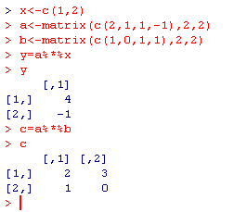
Matrix operations

Slide 23
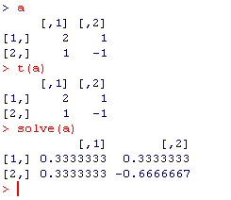
Matrix operations
Matrix operators/functions:
transpose b=t(a)
b = a^{T}
Inverse
b=solve(a)
b = a⁻¹ (when needed)

Slide 24
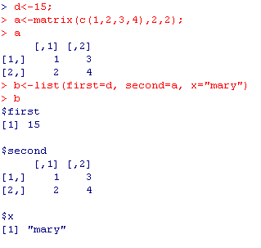

Lists
List is a collection of objects

Slide 25
Data frames
Collecting vectors and matrices with the same number of rows in a data frame
Use the function data.frame(object 1, object 2, … , object k)
Matrices need to be protected , otherwise each column of a matrix will be identified as a single object in the data frame.
Protection is made with the function I()

Slide 26
Data frames
Objects within a data frame can be called upon using the syntax
dataframe$object

Slide 27
Data frames
Names of objects within a data frame can be called, set or changed by handling the object
names()

Slide 28

Read data from file
Assume we have our data stored on the file demo.dat in directory D:\undv\732A26
x a.1 a.2
1 2 1
2 1 -1
First, set correct working directory in R:

Slide 29
Read data from file
To read from the file, use the function
read.table(filename,header=logical_value,sep=separator)
filename is the name of the file
logical_value is set to TRUE if file have headers, otherwise it should be set to FALSE
separator (default is ” ” for blank-separated columns)

Slide 30
Read data from file
Note! read.table treats every column of the file as an individual column, i.e. it cannot be used to read a matrix directly into the workspace
The columns of a stored matrix must be recombined to create the matrix

Slide 31
Read from Excel file
Save file as comma-separated file (csv)
Use
read.csv(file, header = TRUE, sep = ",", quote="\"", dec=".", fill = TRUE, comment.char="", ...)

Slide 32
Write to an external file
write.table(dataframe,filename,append=logical_value,sep=logical_value,quote=logical_value,row.names=logical_value,col.names=logical_value)
dataframe is the name of the data frame to be written on file
filename is the name of the file to write to
logical_value is either TRUE or FALSE

Slide 33
Write to an external file
Examples:
Exploring demo1.dat with Notepad (“Anteckningar” in Swedish)

Slide 34
Conditional execution
if (expr) {
…
}
else{
…
}
If you need to connect several conditions, use ’&’ , ’&&’, ’| ’ or ’||’

Slide 35
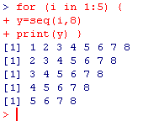
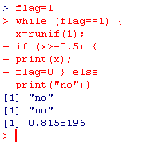
Loops
for (name in expr1 )
{
…
}
while (condition)
{
…
}

Slide 36
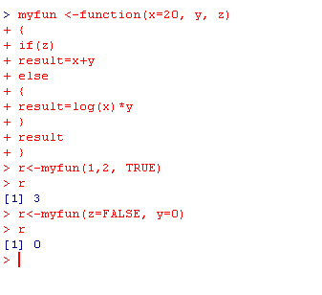
Writing your own functions
Function writing must always end with writing the value which should be returned!

Slide 37
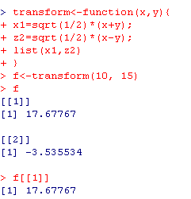
Writing your own functions
If several arguments need to be returned, list may be used

Slide 38
Graphical procedures
plot(x,..) plots time series
plot(x,y) scatter plot
hist(x,..) plots a hitogram
3D graphics should be searched in other packages…

Slide 39
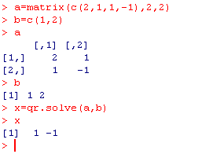
Some examples
Solving a linear system of equations

Slide 40
Some examples
Regression model

Slide 41
Some examples
Use help(”lm”) to learn more about this function

Slide 43
Example 2: Simulating regression data
x1=c(2,3,5,6,9,10,10,12,13,15) # First x-variable
x2=c(1,0,0,1,0,1,1,0,1,1) # Second x-variable
y<-as.numeric(1:10) # Dimensioning y
for (i in (1:10)) {
# Computing y using beta1=1.1 and beta2=-4.7
# Random error is N(0,2)
y[i]=12+1.1*x1[i]-4.7*x2[i]+rnorm(1,0,2) }
Plot(x1,y) # generates a scatter plot y vs. x1
# Estimating the coefficients:
x=cbind(rep(1,each=10),x1,x2)
b=qr.solve(x,y)
print(b)
Store in file regress.r

Slide 44
A more complex example: Simulating regression data
Script:
x1=c(2,3,5,6,9,10,10,12,13,15) # First x-variable
x2=c(1,0,0,1,0,1,1,0,1,1) # Second x-variable
y<-as.numeric(1:10) # Dimensioning y
for (i in (1:10)) {
# Computing y using beta1=1.1 and beta2=-4.7
# Random error is N(0,2)
y[i]=12+1.1*x1[i]-4.7*x2[i]+rnorm(1,0,2) }
Plot(x1,y) # generates a scatter plot y vs. x1
# Estimating the coefficients:
x=cbind(rep(1,each=10),x1,x2)
b=qr.solve(x,y)
print(b)
Store in file regress.r

Slide 46
Suppose we would like to get empirically derived confidence limits for β₁ , i.e. not using the normal distribution.
beta1<-as.numeric(1:500) # Dimensioning array of b1-values
x1=c(2,3,5,6,9,10,10,12,13,15) # First x-variable
x2=c(1,0,0,1,0,1,1,0,1,1) # Second x-variable
y<-as.numeric(1:10) # Dimensioning y
for (trial in 1:500) {
for (i in (1:10)) {
# Computing y using beta1=1.1 and beta2=-4.7
# Random error is N(0,2)
y[i]=12+1.1*x1[i]-4.7*x2[i]+rnorm(1,0,2) }
# Estimating the coefficients:
x=cbind(rep(1,each=10),x1,x2)
b=qr.solve(x,y)
# Storing b1 in array
beta1[trial]=b[2] }
Store in file regress2.r

Slide 49
Final comments
Huge more to find out!
Use the PDF manual (read at least the first chapter)
Use the help function (help(”function”) or ?function
Use Google (search for “R: what you are looking for”)

